Slide 1

Git and GitHub:
Understanding
01s^{t} October 2024.

Slide 2
Git and GitHub:
Content:
What is Version Control?
Introduction to Git
Git Vs SVN
Basic Git Workflow
Branching and Merging
Resolving Conflicts
GitHub Overview
Advanced Git and GitHub Techniques
Hands-on Assignment
Q&A

Slide 3
What is Version Control?
Definition Version Control is a system that records changes to files or sets of files over time, allowing you to:
Track Changes:
Collaborate:
Restore Versions:
Types of Version control:
1. Local Version Control:
Stores changes in a local directory on your computer.
2. Centralized Version Control (CVCS): (Eg. SVN )
All team members pull and push changes to/from a central server.
3. Distributed Version Control (DVCS): (Eg. Git)
Every developer has a full copy of the project’s history on their machine. Changes can be pushed and pulled between multiple repositories.

Slide 4
Git Vs SVN
Git Vs SVN
Feature | Git | SVN
Type | Distributed | Centralized
Branching | Lightweight, frequent branching | Heavier, directory-based branches
Performance | Fast (local history and operations) | Slower (network-dependent)
Collaboration | Distributed workflow | Centralized workflow
Storage Model | Snapshots (entire repository state) | Deltas (changes between versions)
Learning Curve | Steeper, more complex commands | Easier for beginners
Conflict Resolution | Powerful and flexible | Less advanced tools

Slide 5
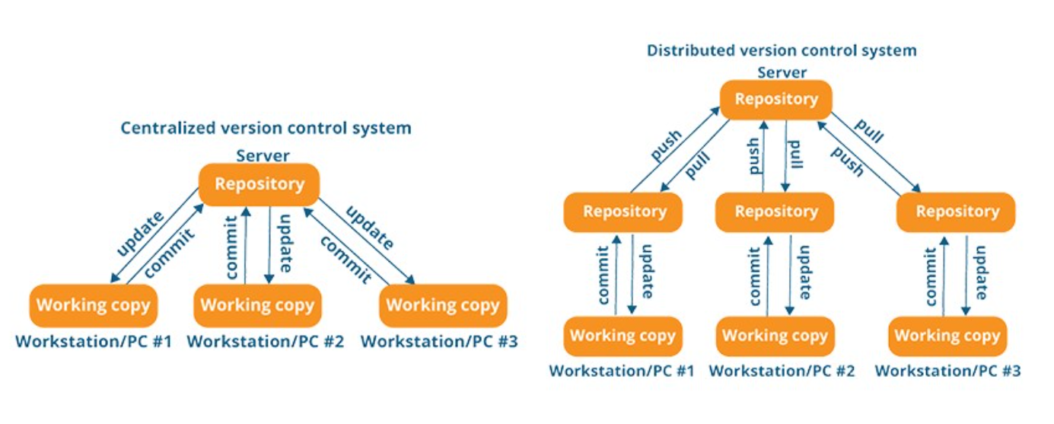

Slide 6
Introduction to Git and GitHub
What is Git?
Git is a distributed version control system (DVCS) designed to handle everything from small to very large projects with speed and efficiency. It enables multiple developers to work on a project at the same time without overriding each other's changes.
What is GitHub?
GitHub is a Cloud-based platform built around Git that provides:
Remote Hosting: A place to store Git repositories online so that teams can collaborate on the same project from different locations.
Collaboration Tools: GitHub offers tools like pull requests, issue tracking, and project management features that make teamwork easier.
Open Source Community: Many open-source projects are hosted on GitHub, making it a central hub for developers around the world to collaborate and contribute.

Slide 7
Git Workflow:
Git States: Modified, Staged, Committed.
Git Workflow:
Modify files
Stage changes (git add)
Commit changes (git commit)
Push changes to remote (git push)
Basic Commands:
git init: Initialize a repository.
git clone: Clone a remote repository.
git status: Check current repository status.
git add: Stage files for commit.
git commit: Save staged changes.
git log: View commit history.
Modify files
Stage changes
Commit changes
Push change

Slide 8
Basic Git and GitHub Workflow:
Git is the version control tool you use locally to manage your project’s versions.
GitHub is a cloud-based platform where you can store Git repositories online and collaborate with others.
Step 1: Create a Git Repository:
On your local machine, create a new project folder and initialize a Git repository using:
git init
Step 2: Stage and Commit Changes:
After editing files, you can stage changes using git add <filename> and commit them to the repository using:
git commit -m "Initial commit"
Step 3: Create a GitHub Repository:
Go to GitHub and create a new repository. You can name it anything, and choose whether it's public or private.
Step 4: Push to GitHub:
Connect your local Git repository to the GitHub repository:
git remote add origin https://github.com/username/repository.git
git push -u origin master
Step 5: Collaborate:
Team members can now clone the repository, create their own branches, make changes, and push them back to GitHub.
When changes are ready, they can open a pull request on GitHub to merge their changes into the main project.

Slide 9
Create a Git Repository
Stage and Commit Changes
Create a GitHub Repository and Connect your local Git repository to the GitHub repository
Push to GitHub
Collaborate

Slide 10
Branching and Merging
Branching and merging are essential concepts in Git that allow teams to work on different parts of a project simultaneously and then integrate the work smoothly.
What is Branching?
A branch in Git is like a parallel version of your project where you can work independently from the main line of development.
The main branch (also called master in older versions of Git) contains the stable version of the code, while branches are created to work on new features, bug fixes, or experimental changes without affecting the main codebase.
Why Use Branches?
Allows multiple people to work on different features simultaneously.
Keeps the main branch clean and stable while development occurs in isolated branches.
Facilitates better collaboration and easier testing of new changes.

Slide 11
What is Merging?
Merging is the process of integrating changes from one branch into another. After you’ve completed the work on a branch, it’s time to merge the changes back into the main branch (or another branch).
Git offers two main types of merges: Fast-Forward Merges and Three-Way Merges.
What is a Merge Conflict?
A merge conflict happens when Git cannot automatically resolve differences between two branches, often when the same lines of code have been modified in both branches.
How to Resolve a Merge Conflict:
Git will notify you of the conflict and mark the conflicting areas in the files.
Open the conflicting file, and you'll see the conflict markers (<<<<<<, ======, >>>>>>) showing the differences between the branches.
Manually resolve the conflict by editing the file to keep the correct version of the code.
After resolving the conflicts, stage the file with git add and complete the merge with git commit.

Slide 12
Best Practices for Branching and Merging
Create small, focused branches: Each branch should focus on a specific task, like developing a feature or fixing a bug. This makes merging easier and minimizes conflicts.
Regularly update your feature branch: If other team members are committing to the main branch, periodically pull the latest changes from the main branch into your feature branch to avoid large merge conflicts later.
Commit frequently and meaningfully: Make small, incremental commits with clear messages so it’s easy to track changes when merging.
Use pull requests for merges: When working with teams, use GitHub's pull request feature to discuss and review changes before merging into the main branch.

Slide 13
Summary of Key Commands
Action | Command
Create and switch to a new branch | git checkout -b <branch-name>
Switch to an existing branch | git checkout <branch-name>
Merge a branch into the current one | git merge <branch-name>
View all branches | git branch
View the merge status | git status
Abort a merge | git merge --abort
Rebase a branch onto another | git rebase <branch-name>

Slide 14
Resolving Conflicts
Common Causes of Conflicts:
Simultaneous updates: Multiple developers working on the same codebase.
Rebasing: Rewriting commit history during rebase can cause conflicts when reapplying commits.
File deletions/renames: If a file is deleted or renamed in one branch and modified in another.

Slide 15
GitHub Overview
Resources for Hands-on Assignment:
GitHub Documentation: https://docs.github.com
Git Book: https://git-scm.com/book/en/v2
HowtoGit

Slide 16
Hands-on Assignments
1. Set Up a Repository Locally and on GitHub
2. Clone a Repository and Make Changes
3. Branching and Merging
4. Fork a Repository and Submit a Pull Request
5. Resolving Merge Conflicts

Slide 17
Advanced Git Techniques
Rebase vs Merge:
Merging creates a new commit for merge.
Rebasing rewrites commit history (git rebase).
Stashing Changes: git stash.
Cherry-picking Commits: git cherry-pick <commit-hash>.
Squashing Commits: Cleaning up commit history using interactive rebase (git rebase -i).
GitHub PAT

Slide 18
Any
Questions?

Slide 19
Thank You
For Your Attention

